Slide 1
CIVITAS SUNRISE
Laying the foundation for sustainable neighbourhood mobility planning
1
29 September 2017
Hana Peters

Slide 2
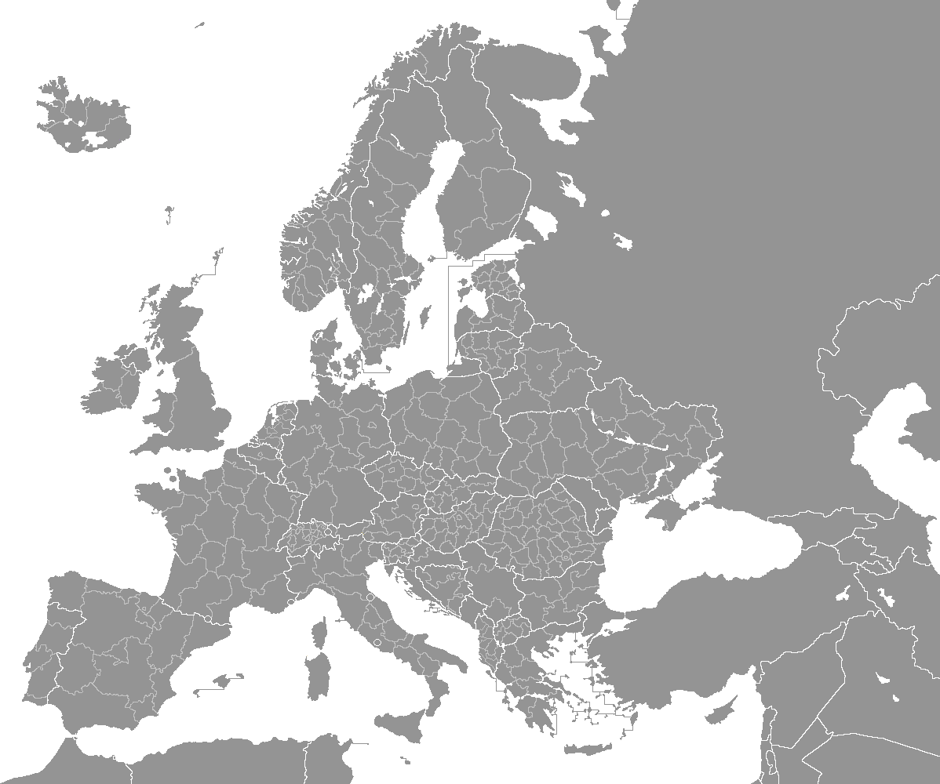
Address mobility challenges at the neighbourhood level in six cities across Europe and the Middle East
Bremen
Budapest
Jerusalem
Malmö
Southend-on-sea
Thessaloniki

Slide 3
The neighbourhoods
Key issues
A variety of characteristics
Congestion
Severe air and noise pollution
Busy roads as physical barriers
Safety issues
Lack of public spaces and places to sit
Low levels of public transport service
High car usage and ownership rate
Parking problems
Central and suburban
Low-income to upper middle class
Varying employment levels
Historic and newer areas
Young population to higher percentage of elderly people
Ranging from 0.10 to 1.84 km2
Ranging from 2.000 – 13.000 inhabitants

Slide 4
Activities along the entire innovation chain
with special attention paid to ensure:
Inclusive representation of society
Bringing in new stakeholders
Co-identification of mobility problems
Co-development of solutions
Co-implementation of measures
Co-evaluation
Learning and knowledge transfer

Slide 5
Aspirations and expectations
Share relevant,
widely endorsed,
tangible,
and replicable results,
and to
make transparent the mechanisms that got us there.

Slide 6
Risks and concerns
What happens if we face difficulties reaching certain target groups and thus ensuring that diverse interests and opinions are captured?
How will we deal with protracted discussions and formation of hostile factions within one/ several co-creation fora, not leading to actionable decisions, should such circumstances arise?
We must ensure reliable, consistent and comparable data for evaluation of measures and project results.
What if the project lifetime proves to be an insufficient timescale for engagement?
What if we encounter a lack of interest of stakeholders to participate in partner neighbourhoods, and therefore difficulty achieving a critical mass of participants?
…or a lack of (or change in) interest of city authorities to take up, engage in and support implementation of bottom-up suggestions and measures?
What if the solutions proposed in the co-creation processes are not financially feasible?
…or if there is a dependency on external actors for physical changes in the neighbourhood?

Slide 7
Thank you!
Hana Peters
Rupprecht Consult
h.peters@rupprecht-consult.eu

Slide 8
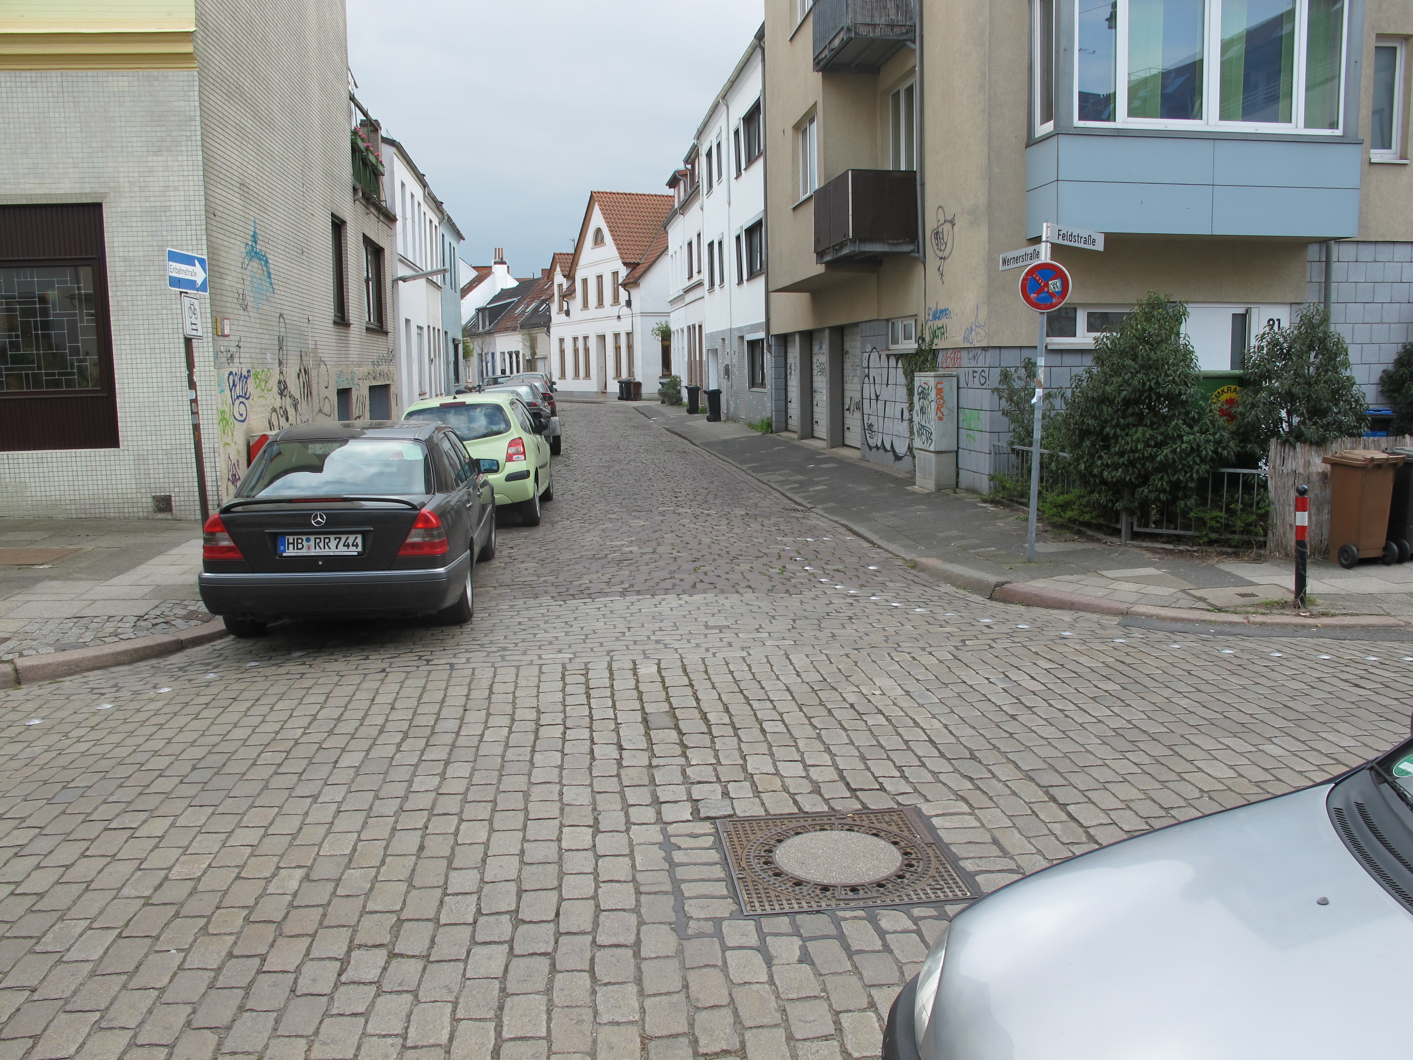
Bremen

Slide 9
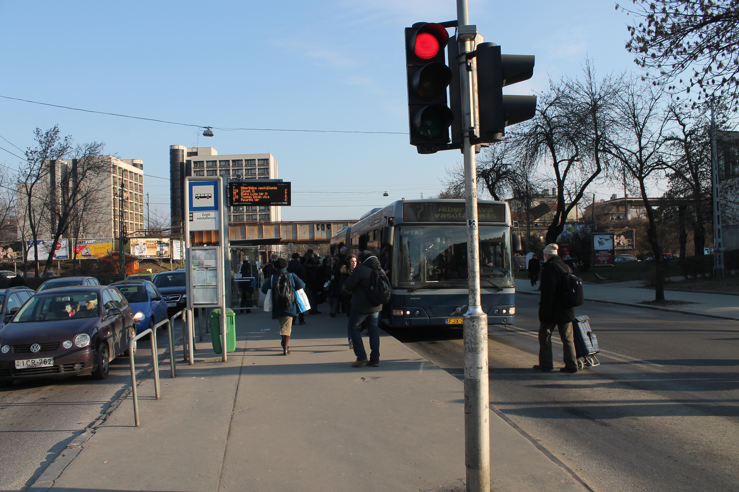
Budapest

Slide 10
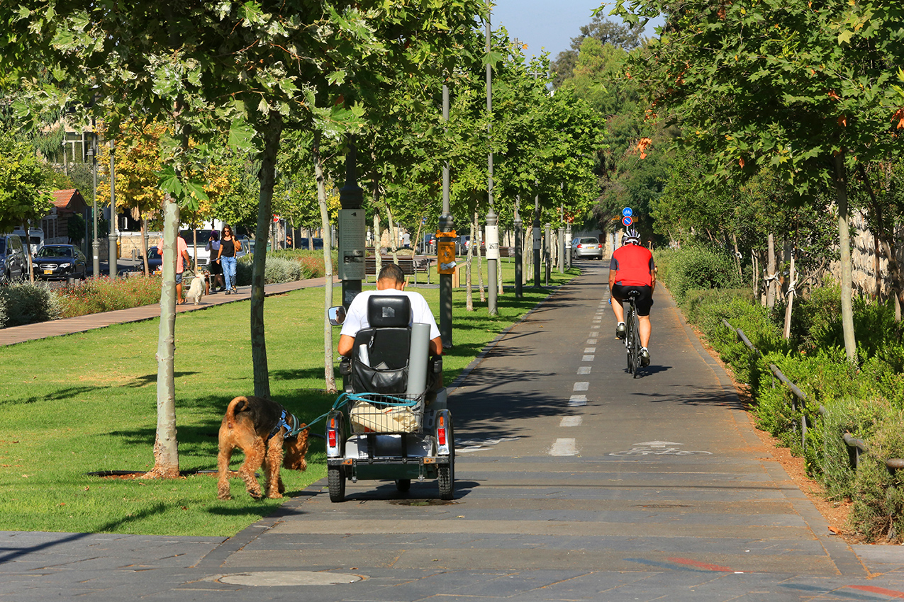
Jerusalem

Slide 11
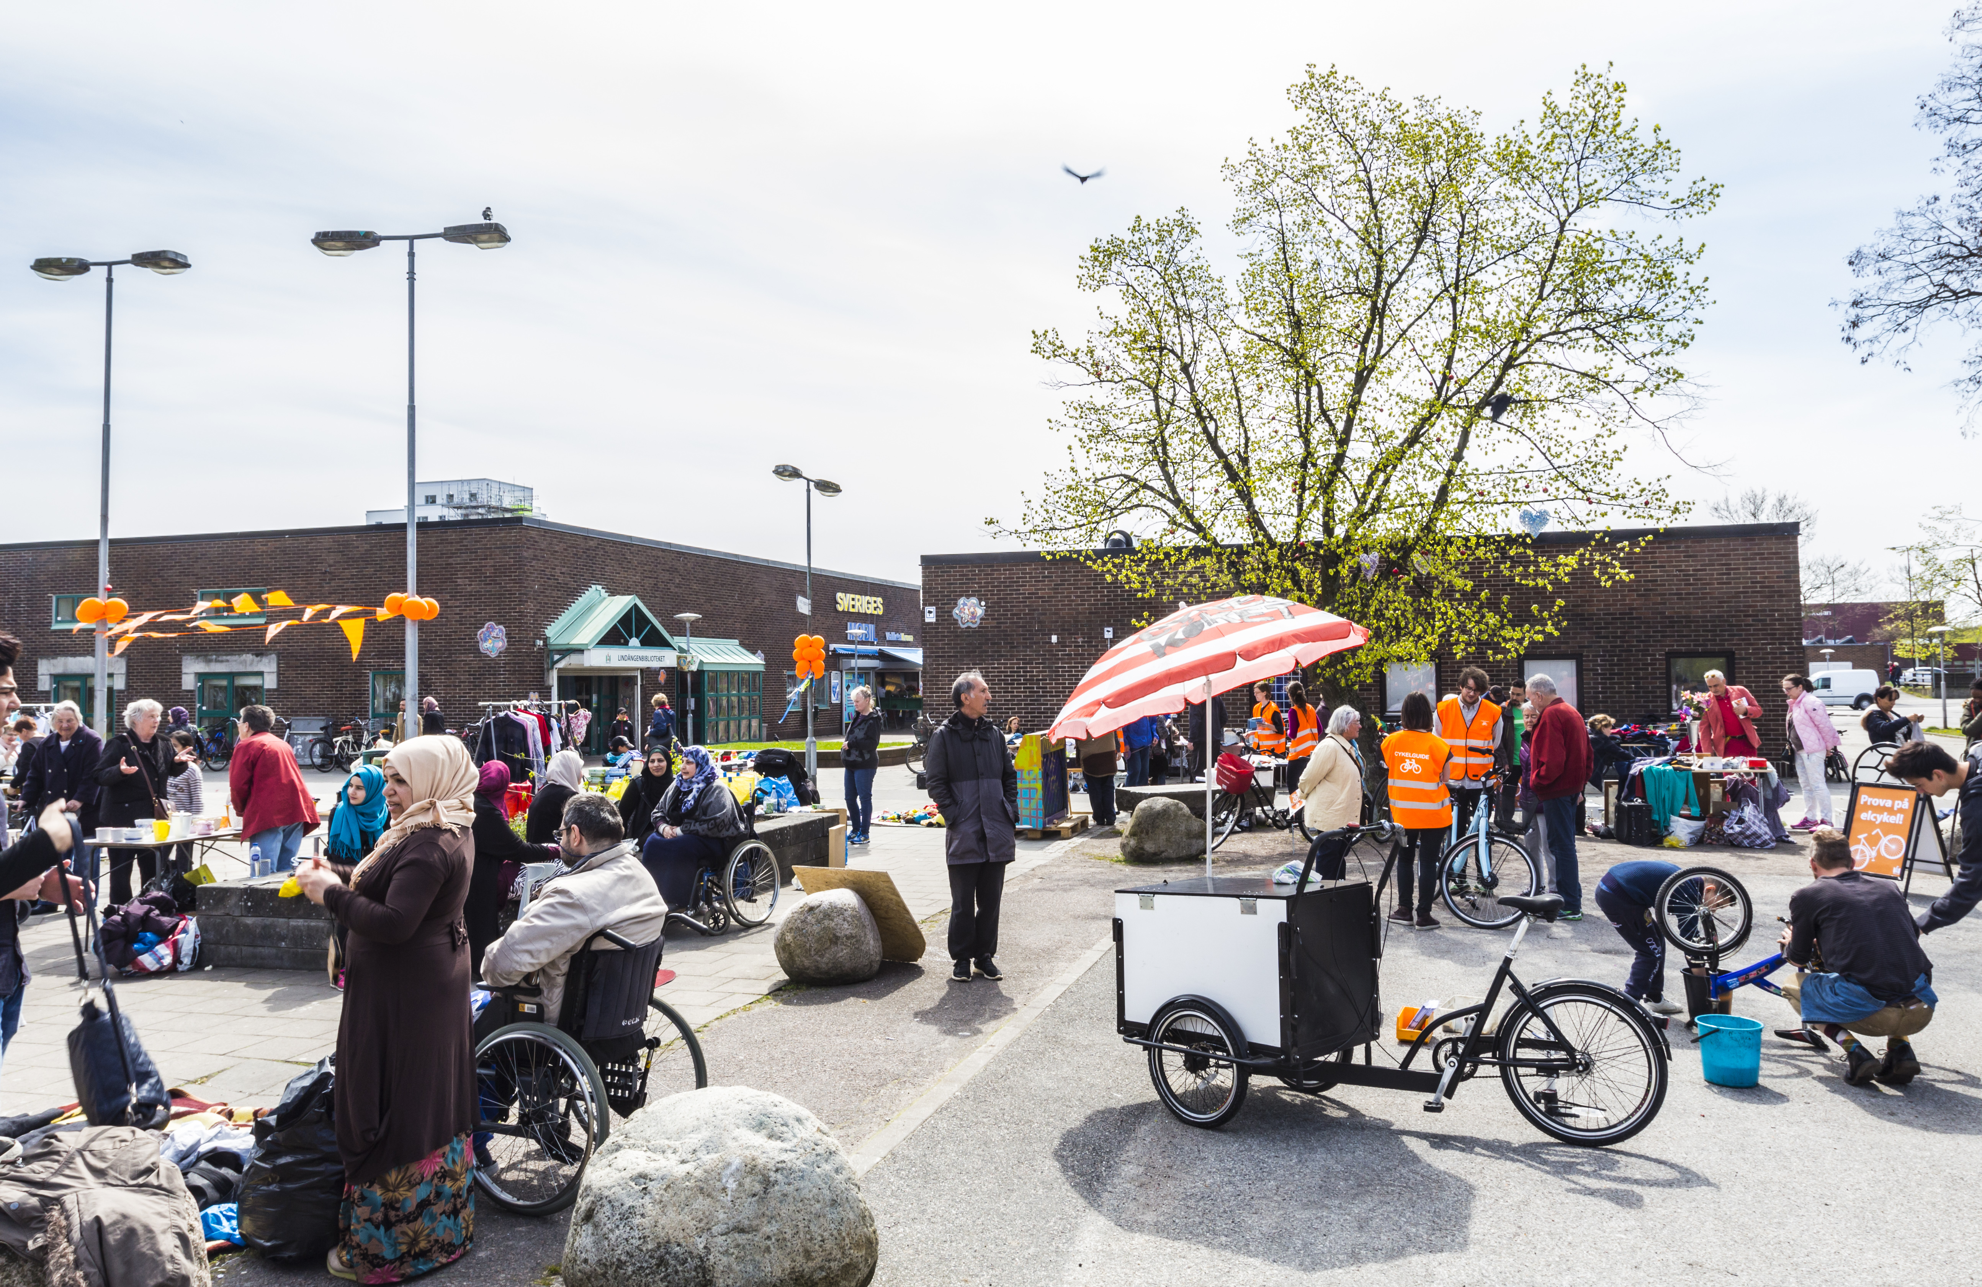
Malmö

Slide 12
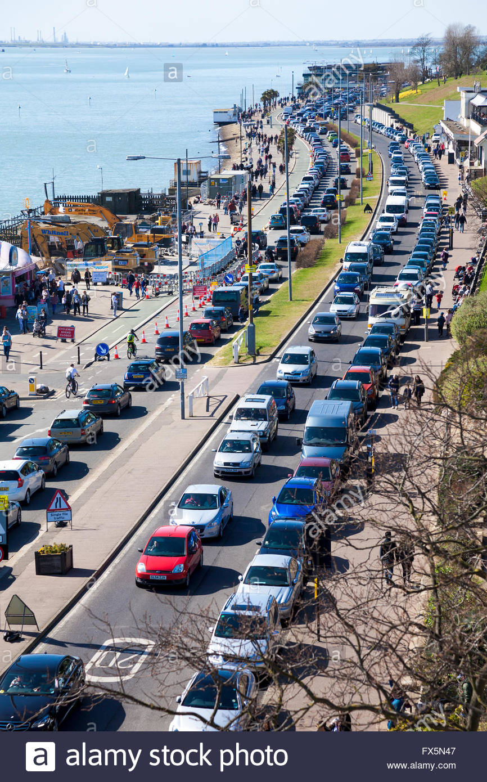
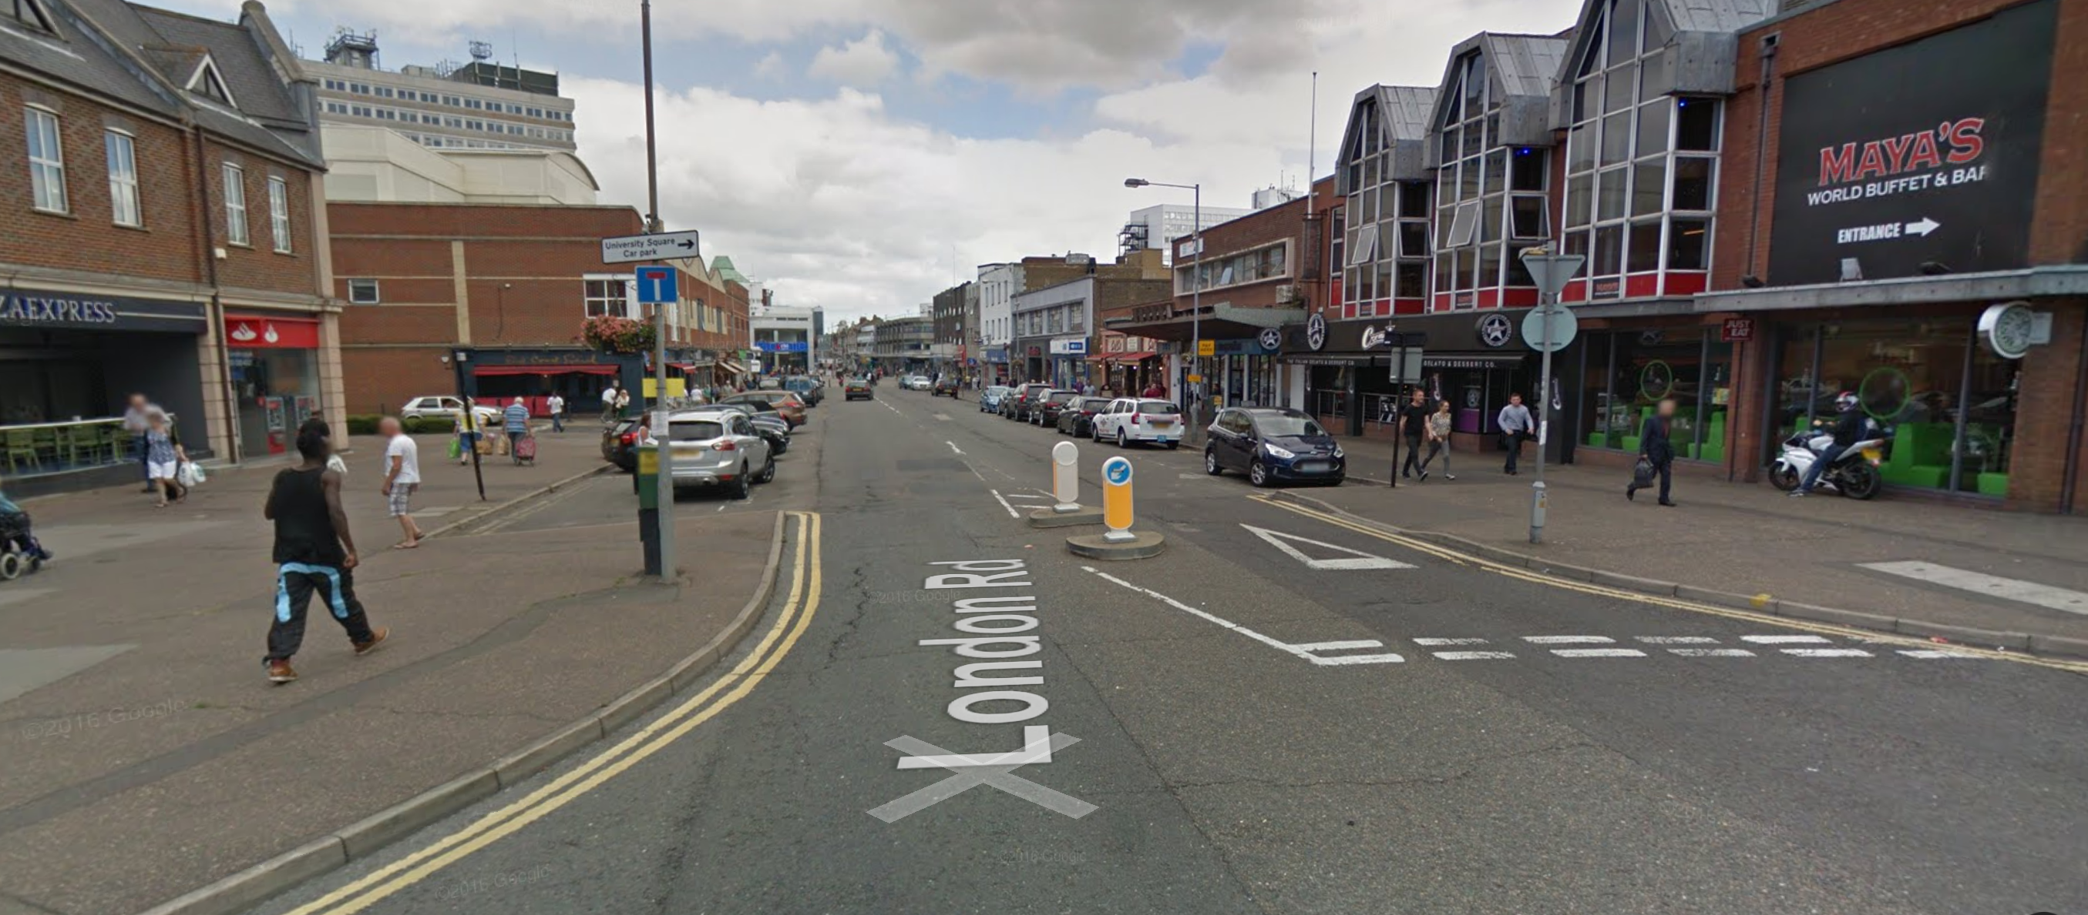
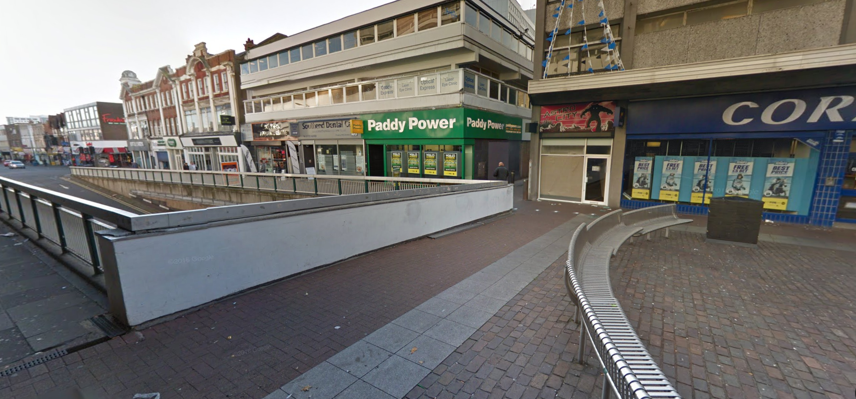
Southend-on-sea

Slide 13
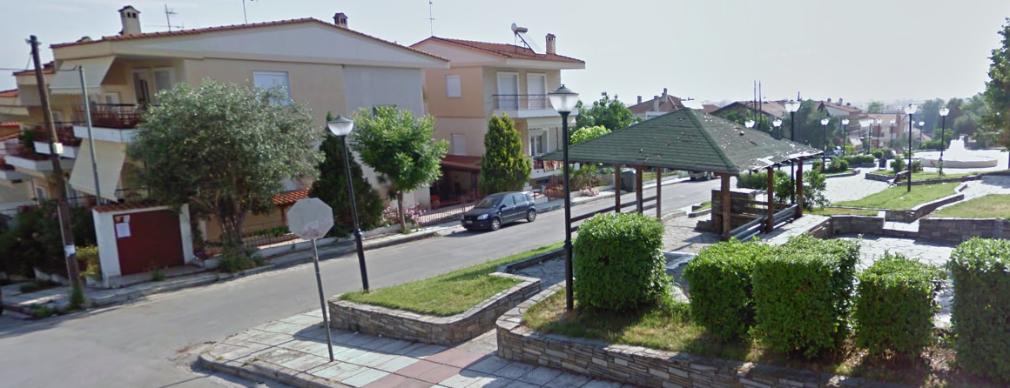
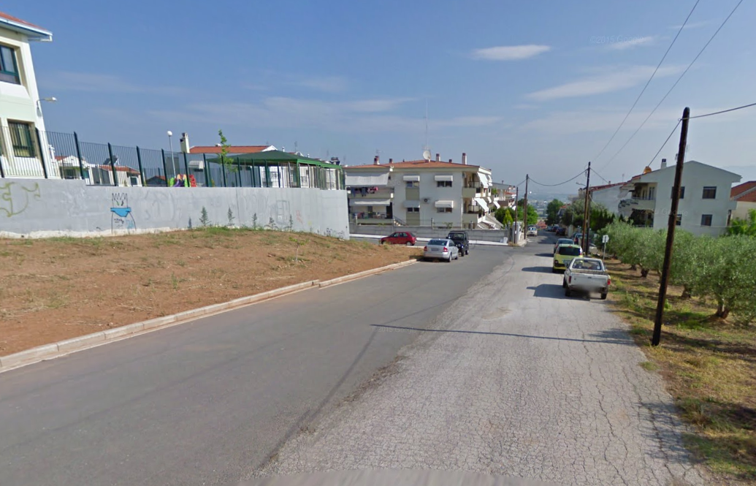
Thessaloniki

Slide 14
Add:
Responses to worries (maybe in notes, not in slides)
Worry about getting sufficient participation

