Slide 1
Budapest – Zugló
Viktor Merker
Senior project manager

Slide 2
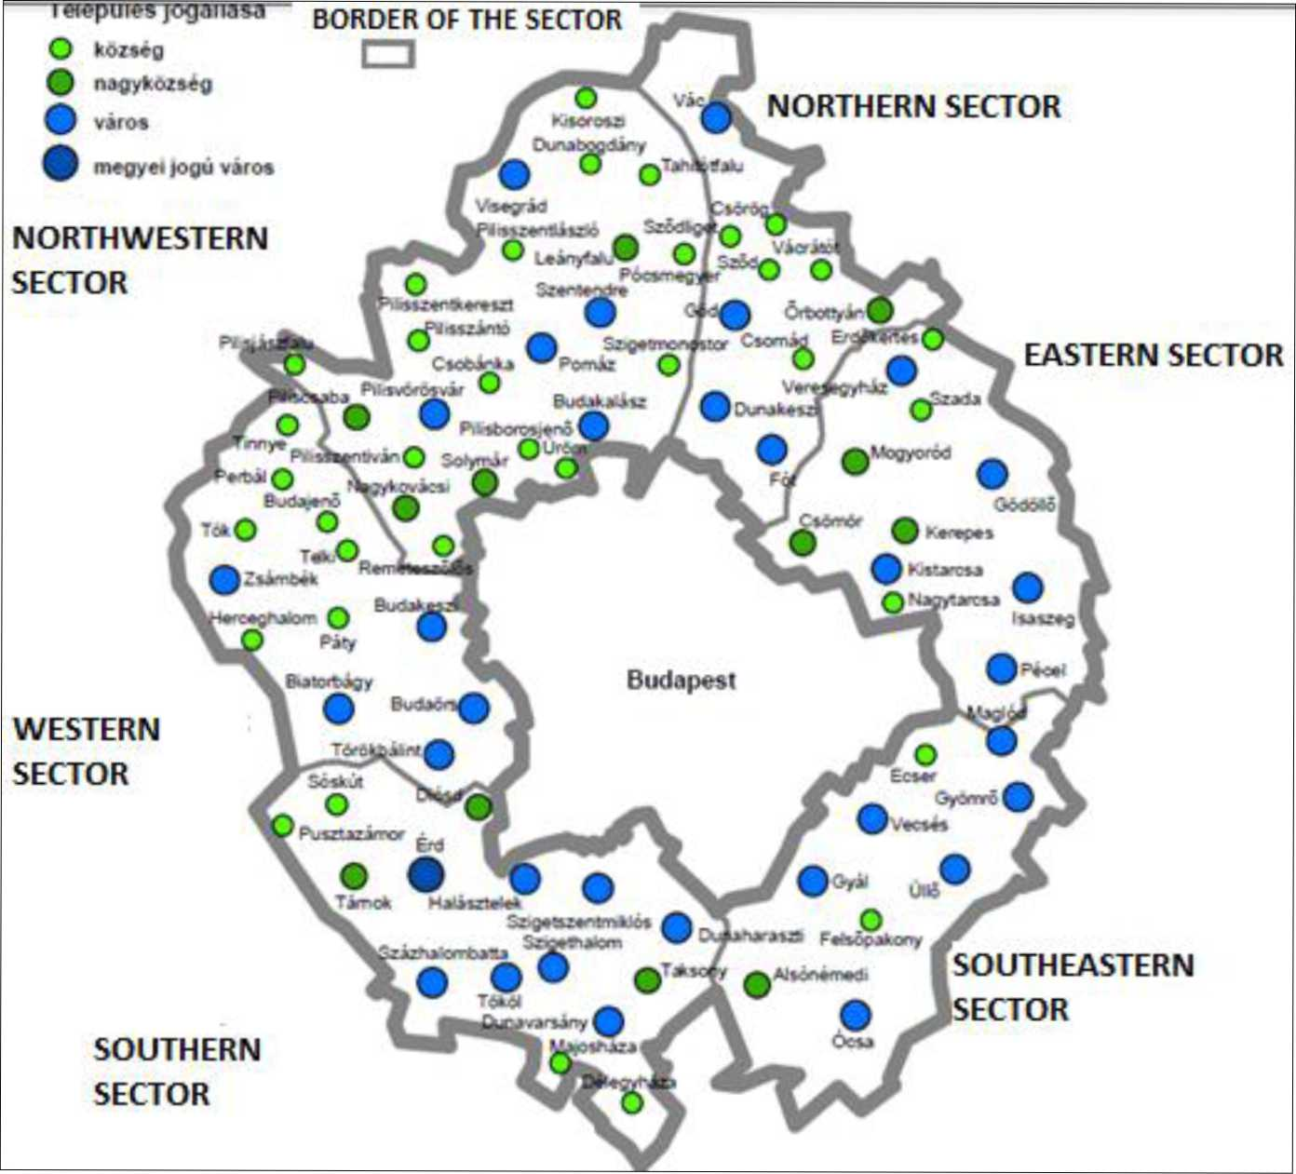
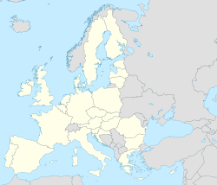
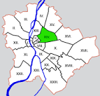
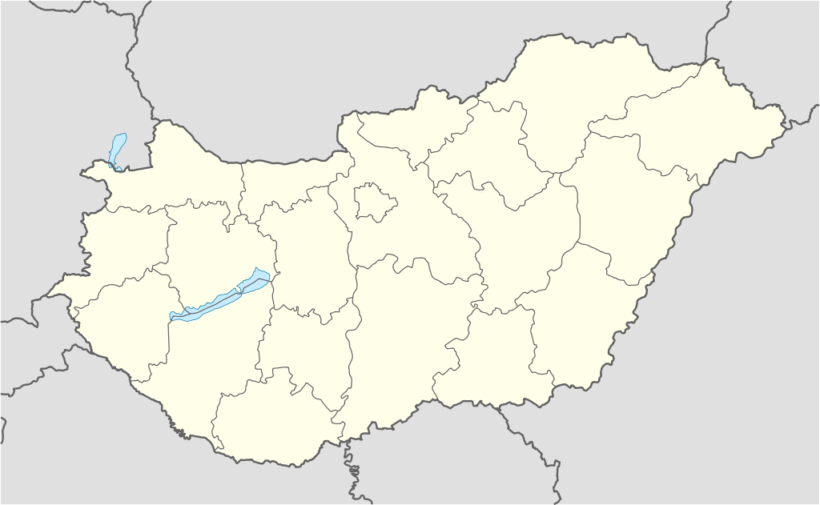
Hungary
Budapest
Hungary: 93.000 km2, 9.850.000 pers.(2015)
Budapest agglomeration: 2538km2, 2.985.000 pers. (2012)
Budapest: 525 km2, 1.758.000 pers.(2015)
Zugló: 18,15 km2, 125.000 pers. (2015)

Slide 3
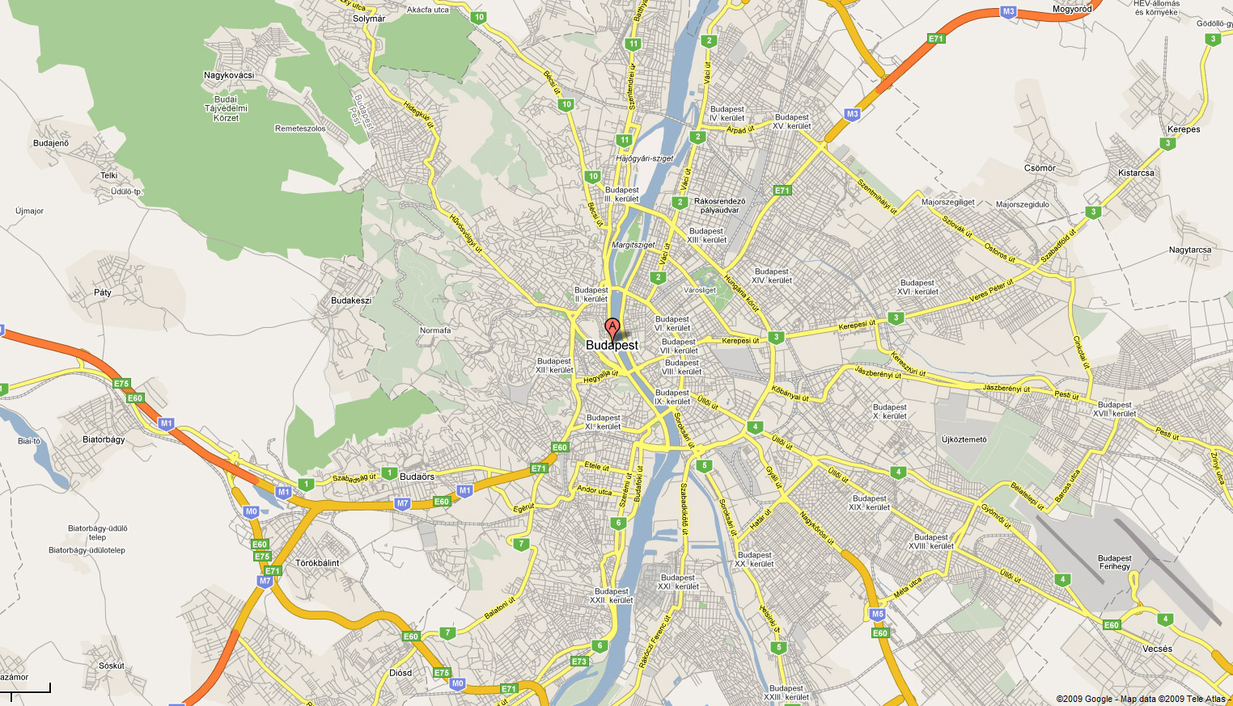

Slide 4
ZUGLÓ
14th District of City of Budapest
14th largest (out of 23)
3rd by population
large and mixed neighborhood,
with communist era style highrise apartments
sprinkled between decently kept family houses
biggest city park VÁROSLIGET
urban highways
2 metro lines
busy rail lines

Slide 5
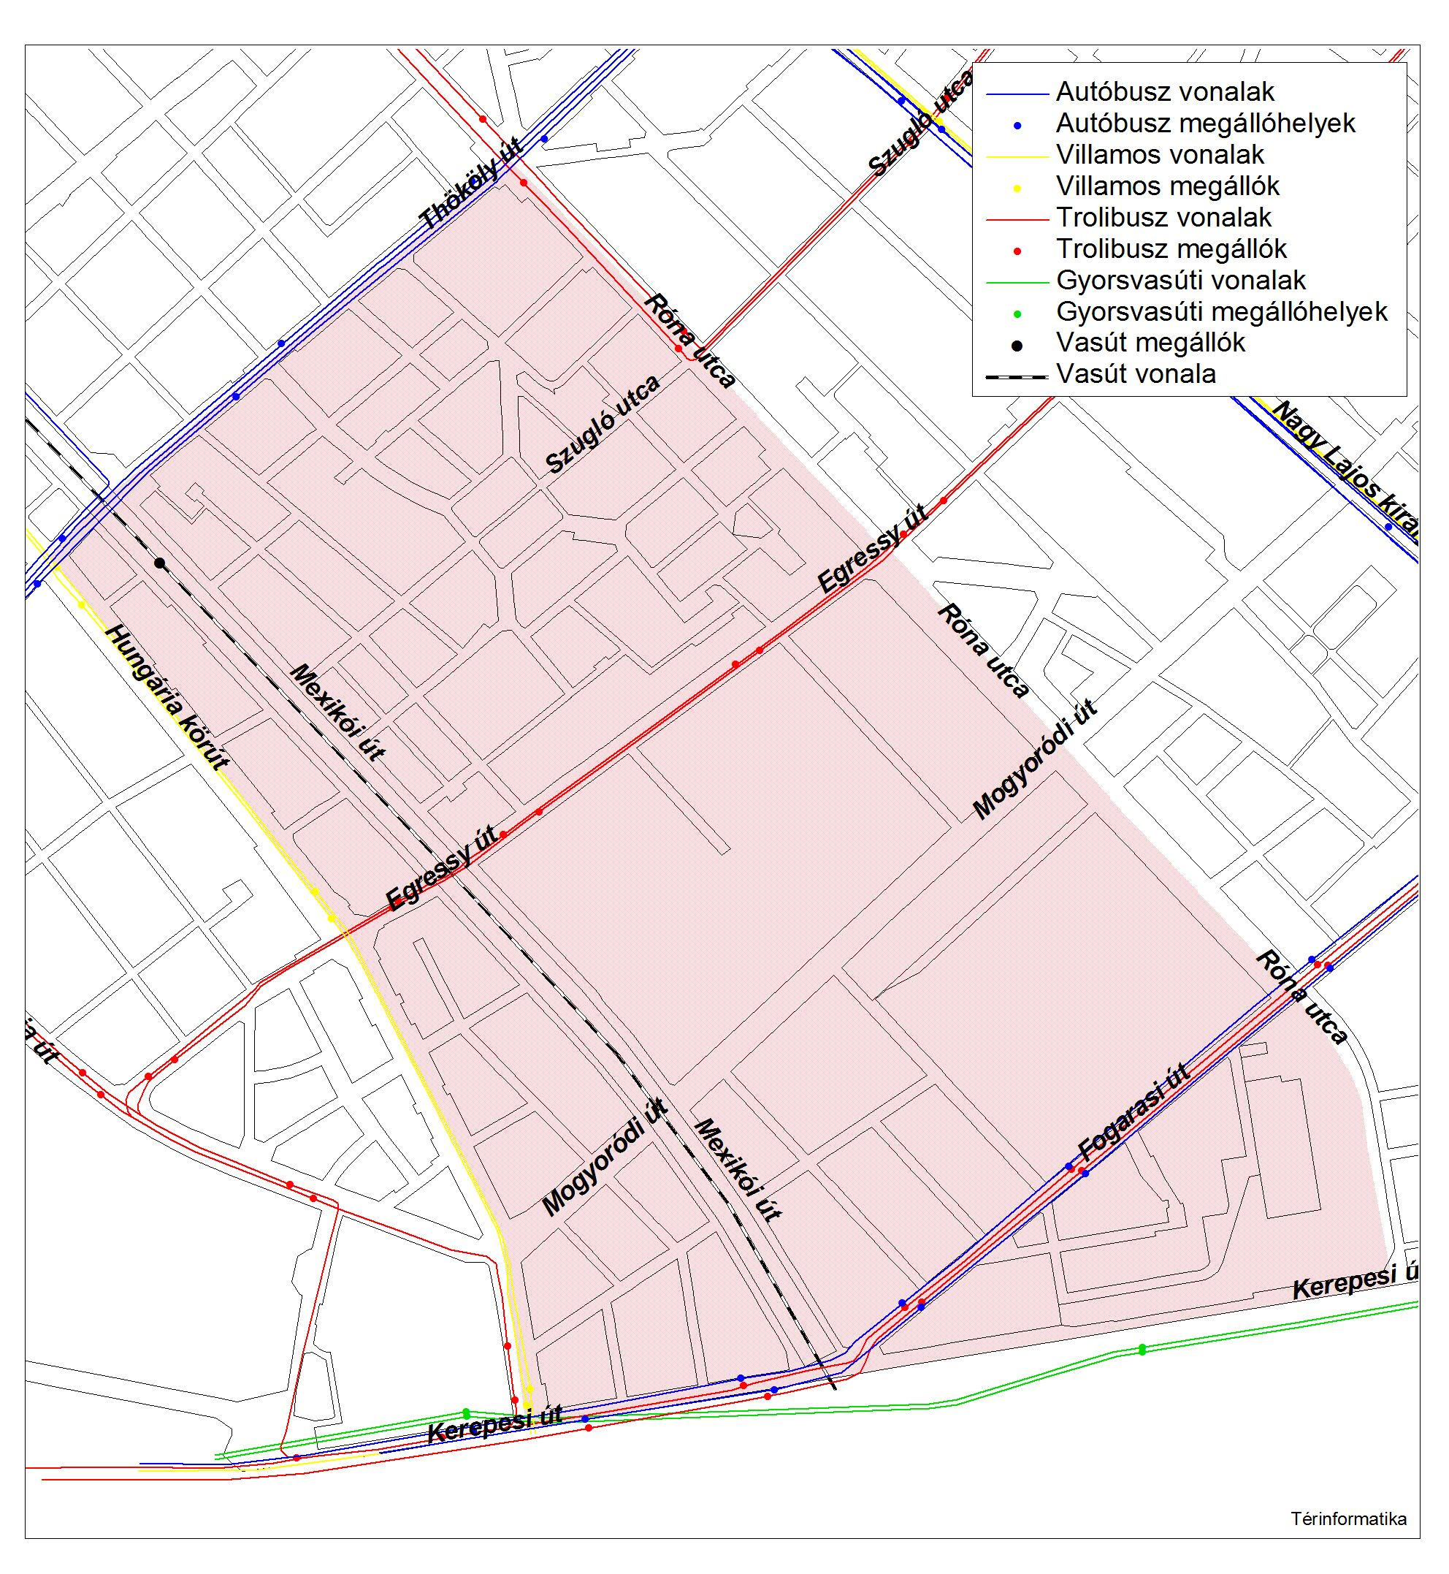
TÖRÖKŐR
1,85 km2
12.045 pers (2015)
PUBLIC TRANSPORT LINES

Slide 6
sunrise.mizuglonk.hu; www.mizuglonk.hu

Slide 7
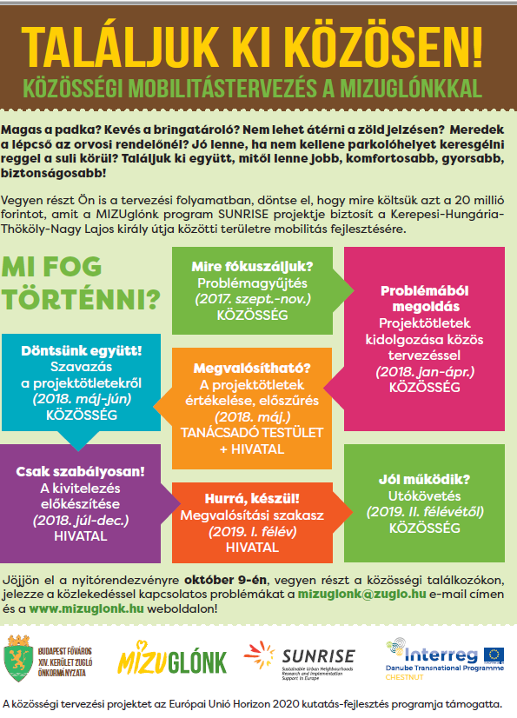

Slide 8
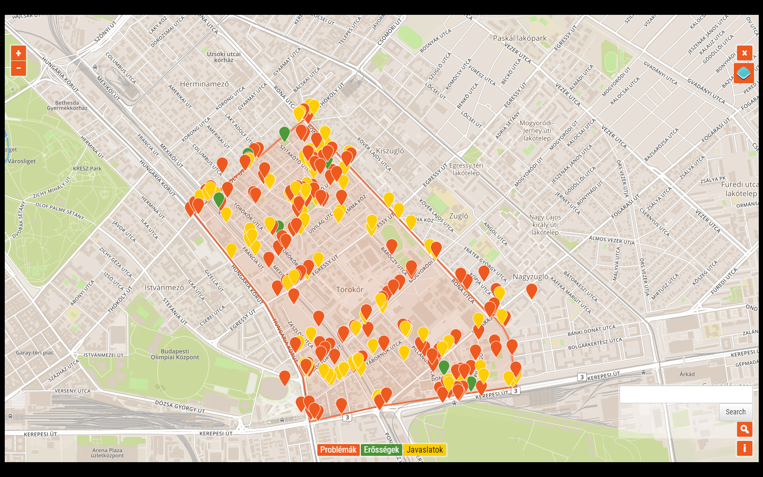
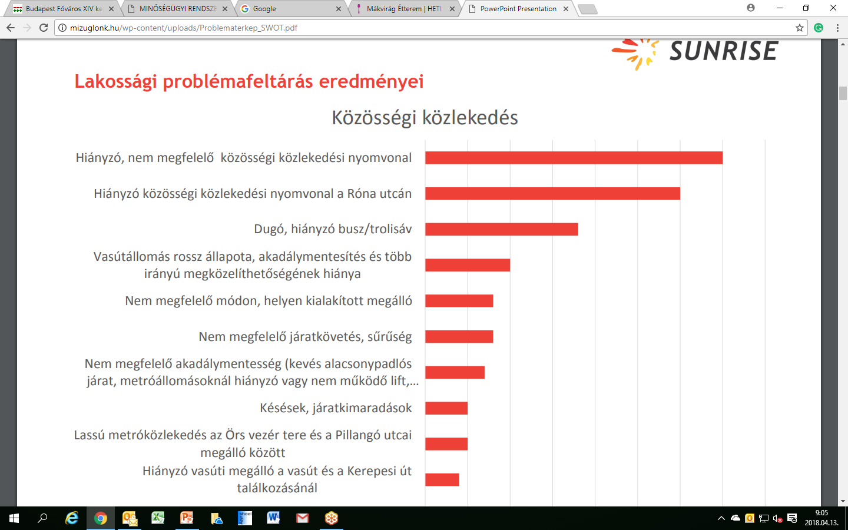
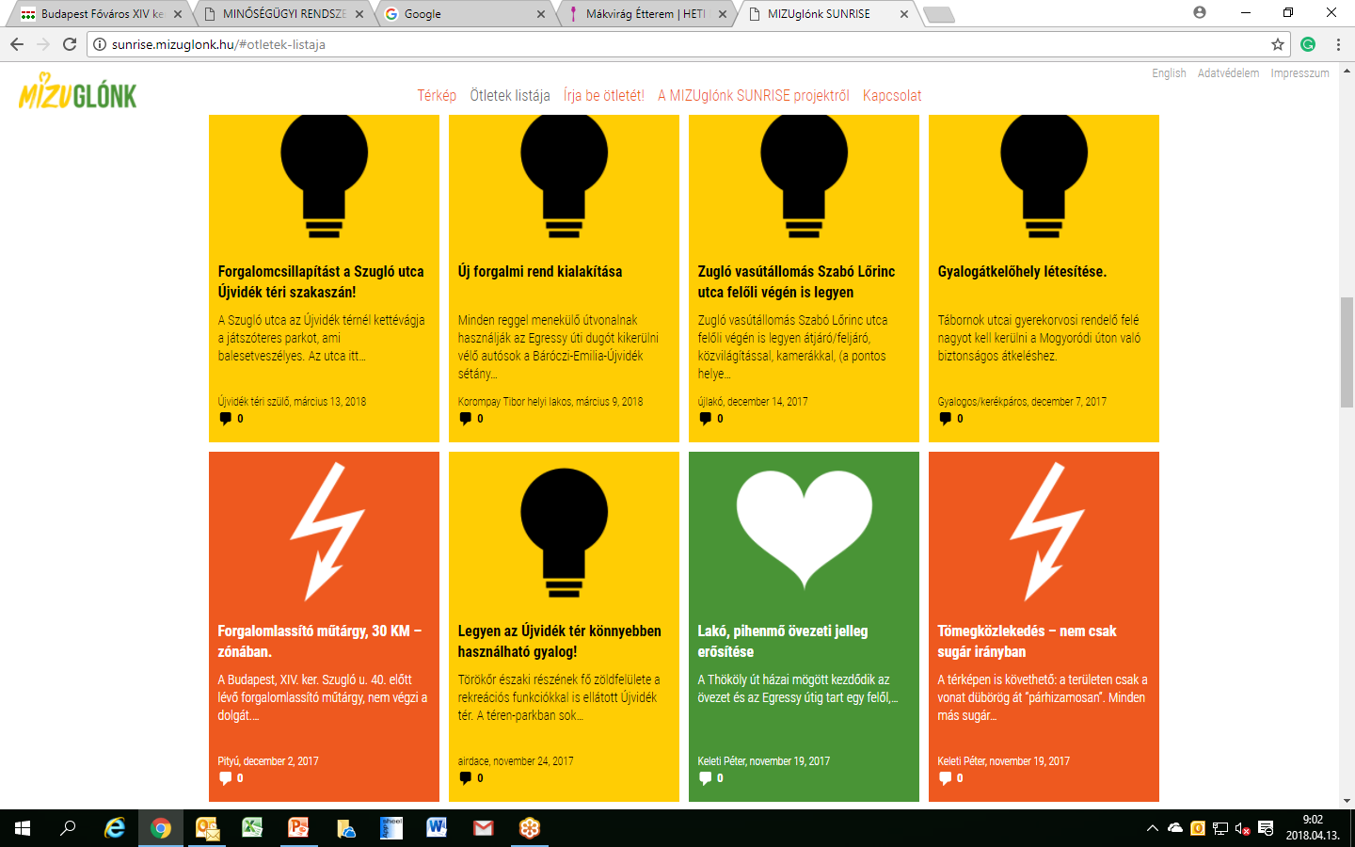

Slide 9
